Slide 1
Emotions Recognition Using EEG Signals: A Survey
2023-Aug-25
12191453 김승한

Slide 2
>>
Table of contents
1. Contribution
2. BackGround
3. Research
Notes:
Contribution과 Main idea는 분리. 논문의 요약을 맨 처음, 그 다음에 배경 지식, 그 다음 조사 과정에서 문제 제기, 방법론, 항목들, 조사 결과(권고 사항) 순으로

Slide 3
Contribution
Introduction
- Electroencephalography (EEG) received considerable attention from researchers
- it provides great time resolution, allowing researchers to study phase changes in response to emotional stimuli
Contribution
1. General Perspective: recommendations to avoid common pitfalls that tend to be performed in this area of research
2. Specific Perspective: the different steps of the process of recognizing emotions from EEG signals

Slide 4
BackGround Emotions
Emotions
- discrete and consistent responses to events (external or internal) with signiﬁcance for the organism
- Feeling: a subjective representation of emotions
- Mood: diffuse affective states
- Affect: a term that is encompassing emotions, feelings, moods
 | Emotion | Mood
duration | shorter | longer
intensity | greater | less

Slide 5
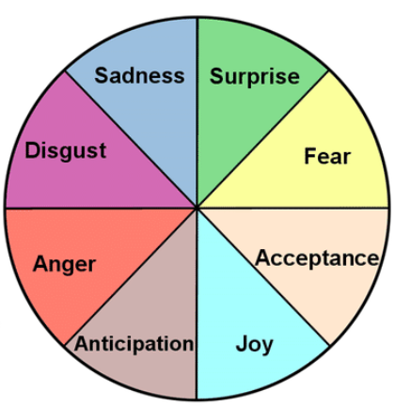
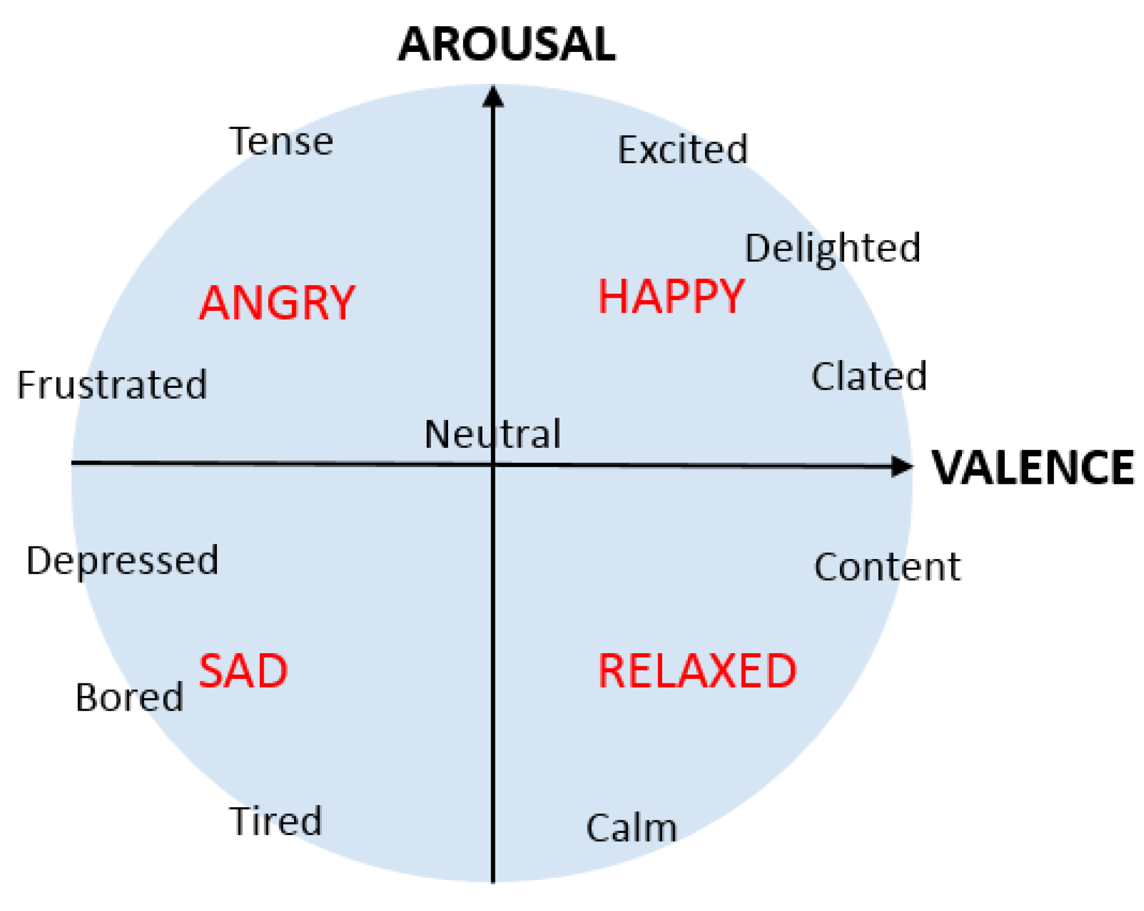
BackGround Emotions
Emotions representation
1. Natural selection
- eight basic emotions: anger, fear, sadness, disgust, surprise, curiosity, acceptance, joy
- all the other emotions can be formed by these basic ones
2. Cognition
- valence, arousal, dominance
Notes:
Cognition에서 가장 흔히 사용되는 모델은 arousal, valence 두 개만 사용

Slide 6
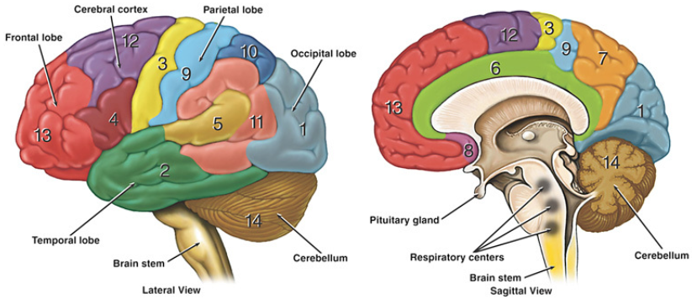
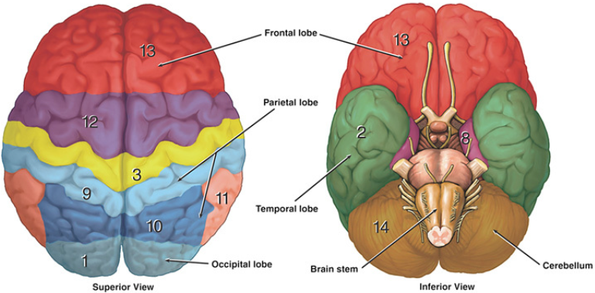
BackGround EEG
Division of the cortex, the portion of human brain
1. The frontal lobe: conscious thought
2. The temporal lobe: sense of the smell and sound, and the processing of complex stimuli
3. The parietal lobe: integrating sensory information
4. The occipital lobe: sense of sight

Slide 7
BackGround EEG
Ranges that EEG signals are divided
1. Delta(1-4Hz): unconscious mind, during dreamless sleep
2. Theta(4-7Hz): subconscious mind, sleeping and dreaming
- emotional stability or sleep, memory, concentration
3. Alpha(8-13Hz): relaxed mental state, yet aware
- amplitude increases in a relaxed state
- suppression of alpha waves during object gaze or mental excitement (alpha blocking)
4. Beta(13-30Hz): an active state of mind
- all conscious activities
- especially anxious, and tense state
5. Gamma(>30Hz): hyper brain activity
- more emotionally anxious state
- highly cognitive information processing such as reasoning and judgment
Notes:
delta는 깊은 수면(무의식), theta는 정서 안정 혹은 수면, 기억력 집중력(잠재의식), alpha는 편안한 상태일수록 진폭이 증가, 물체 주시나 정신적 흥분 시 알파파 억제(알파 저지), beta는 모든 의식 활동, 특히 불안 긴장, gamma는 정서적으로 더 초조한 상태, 추리, 판단 같은 고도의 인지 정보 처리

Slide 8
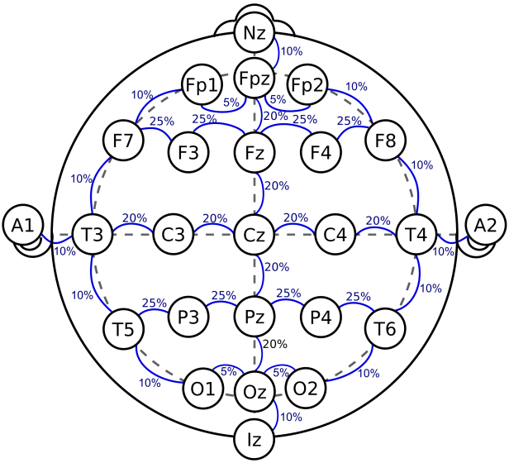
BackGround EEG
EEG electrodes Location
- standardized sets of locations for electrodes on the skull, such as the International 10/20 System
- The numbers 10 and 20 indicate the distance between adjacent electrodes
- With the use of high-density electrodes, multiple sources of noise that can disrupt EEG recordings arise
Notes:
두개골의 앞뒤좌우는 모두 10 혹은 20 거리, 빈 공간에 전극이 추가로 채워질 수 있음 각 글자는 각 lobe 식별, 숫자는 반구체 좌표

Slide 9
BackGround EEG
EEG paradigms
1. SEP(Sensory Evoked Potentials)
- an electrical potential signal recorded after the presentation of a stimulus
- AEP(Auditory): by a click or tone stimulus
- VEP(Visual): by a ﬂashing light or changing pattern on a monitor
+) SSVEP(Steady State): by a periodic stimulus
- SsEP(Somatosensory): by electrical stimulation of the peripheral nerve
2. EVP(Event-Related Potential)
- a very high temporal resolution by immediate responses to short stimuli
 | P100 | N100 | N200 | P200 | P300 | SCP
deflection | positive | negative | negative | positive | positive | -
latency | 100ms | 100ms | 200ms | 200ms | 250~500 | 300ms<
Notes:
뇌의 전기적 활동에서 일어나는 변화를 평가하는 방법들
SCP는 피질 I, II층으로 들어오는 상행성 입력의 동기정도와 세기에 따라 변화하는 신호
SCPs are slow voltage shifts recorded over sensorimotor or frontal cortical areas
SEP는 감각 자극 이후의 전위차 신호, EVP는 자극 이후 반응에 대한 시간과 전위차가 초점

Slide 10
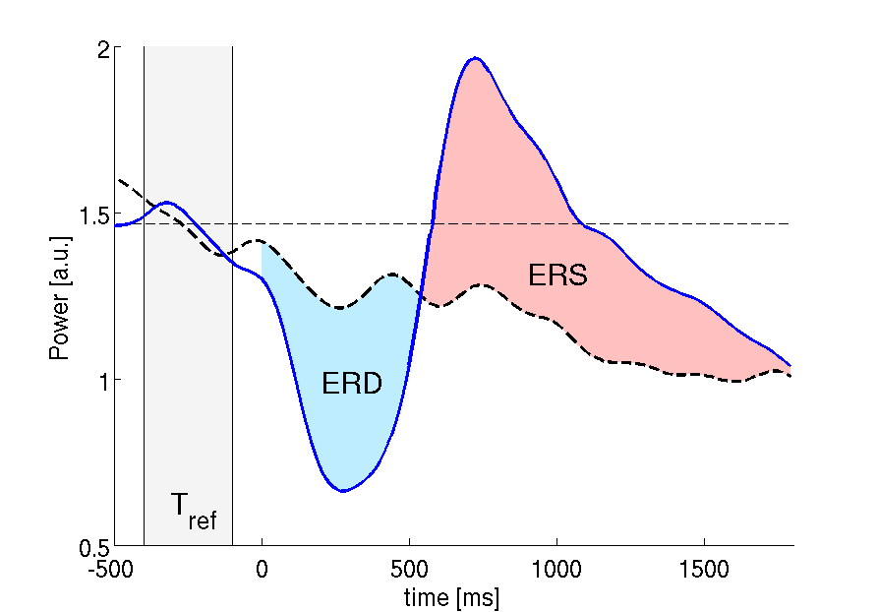
BackGround EEG
3. ERD/ERS(Event-Related De/Synchronizations)
- the evaluation of power changes within speciﬁed frequency bands with a high temporal resolution
- ERS: when power increased after the stimulus
- ERD: when power decreased after the stimulus
Notes:
ERD/ERS는 특정 주파수 대역에서 파워의 변화가 초점

Slide 11
BackGround Emotions in the brain
The brain correlated with emotional activity
- The frontal and parietal lobes are the most informative about the emotional states, while the alpha, gamma and beta waves appear to be the most discriminative
The gender-related findings
- women are more emotional than men, which suggests possible gender-related neural responses to emotional stimuli

Slide 12
Research Method
1. Collect the papers for the survey: : EEG+Emotions+Recognition and EEG+Emotions+Identification between 2009 and 2016
-> 155 papers
2. grouped by author and then removed those that were incremental contributions
-> 142 papers
3. analyzed the quality of the papers, by considering the number of citations
-> 88 papers
4. analyzed the content and novelty of each of the papers below the threshold
-> 99 papers

Slide 13
Research Recommendations
Recommendations to avoid common pitfalls in this area of research
- The recognition of emotions through EEG requires knowledge from different areas
- This is a highly interdisciplinary ﬁeld that is difﬁcult to perform
- the common pitfalls enumerated in this section mainly occur in interdisciplinary regions
Recommendations
1. Deﬁne your state of interest and ground truth
2. Connect your state of interest to neurophysiology
3. Eliminate confounding factors (or at least, do not ignore them)
4. Adhere to good classiﬁcation practice
5. Provide insight into the cause of classiﬁcation success
6. Provide insight into the added value of using neurophysiology

Slide 14
Research Recommendations
1. Deﬁne your state of interest and ground truth
Concept
- clarify which are the mental states addressed by the authors, as well as discuss how it was addressed in previous studies and the deﬁnition in use
- connect the mental state of interest to its operationalization in the work, since it reﬂects what should be consider as ground truth
Problem
- some of the works only collect the signal data, assuming that the stimulus effectively elicited the emotions expected

Slide 15
Research Recommendations
2. Connect your state of interest to neurophysiology
Concept
- connect a given psychological state to certain physiological signals
- formulate hypotheses about the way the neurophysiological measures used are expected to vary with the mental state of interest
Problem
- extract the EEG features without providing any explanation of the relationship between the emotions they intend to recognize and the features they used

Slide 16
Research Recommendations
3. Eliminate confounding factors
Concept
- by properly design the study
- examine the data to verify their existence and, more importantly, to check if the neurophysiological variables vary with the mental state of interest or due to confounds
Problem
- less common is the veriﬁcation of the data to ﬁnd confounds and remove them if they exist
- researchers working with EEG signals apply artifact removal techniques
- authors believe there is no need to observe the data and to manually remove them

Slide 17
Research Recommendations
4. Adhere to good classiﬁcation practice
Concept
- the trained models are used to label unseen neurophysiological data
- by comparing the labels from the known and unseen data
Problem
- some authors do not provide any information about this, or use data from the same session/subject for training and testing

Slide 18
Research Recommendations
5. Provide insight into the cause of classiﬁcation success
Concept
- present information about the way the neurophysiological processes underlying the different features (and combinations of features) differ
Problem
- they only report the results achieved, without any explanation or insights about the results or why some sets of features perform better than others

Slide 19
Research Recommendations
6. Provide insight into the added value of using neurophysiology
Problem
- Only part of the works explained the advantages of the EEG signals over other physiological measures

Slide 20
Research Process of recognizing emotions
The different steps of the process of recognizing emotions from EEG signals
1. The user must be exposed to the stimulus being tested
2. The voltage changes observed in the brain of the user are recorded
3. The noise and artifacts from the recorded signals are removed
4. The resulting data is analyzed and the relevant features are extracted
5. a classiﬁer is trained based on a training set and using the computed features

Slide 21
References
Emotions Recognition Using EEG Signals: A Survey
https://www.laxtha.com/Product.asp?x=2&y=17&z=29&infid=155

